Slide 1
Prima-databot Talk to your building data
Di Zhang
2025/8/14

Slide 2

An opportunity but also a problem
Building data is difficult to use
Generated at different stages, using different software, in different formats.
Excel, CSV
JSON
PDF
Revit

Slide 3
An opportunity but also a problem
Before developing and deploying AI algorithms, huge efforts are needed to
Understand the data
Find the needed information
Pre-process the data
Data DOES NOT lead to values unless they are stored, organized, and utilized in automated ways
Can we make the building data easy to use?

Slide 4
Solution: semantic model
Uses class-instance format
T, t, Temp., temperature
Maps the data to the actual building and system
Data in the database (server, field, tag, etc.)
Location in the building and system
Encodes the relationship between the building and system
Chiller -> AHU -> VAV box -> thermal zone -> space

Slide 5
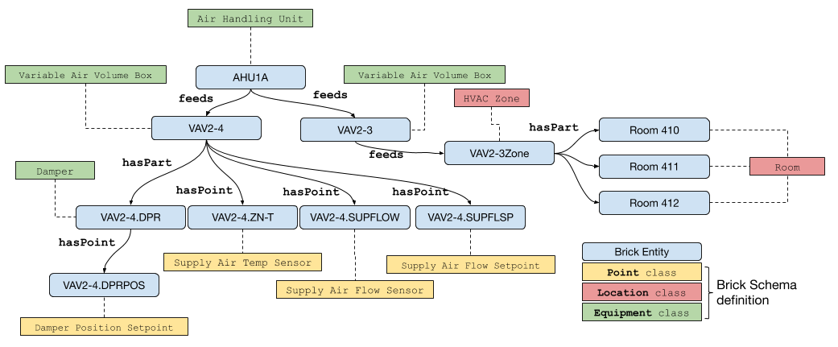
Brick schema: an example

Slide 6
Objectives of the study
Challenges
Querying a brick model requires SPARQL langugae
Objectives
Develop a tool that can automatically generate code to query data from Brick model acoording to user input in natural language

Slide 7
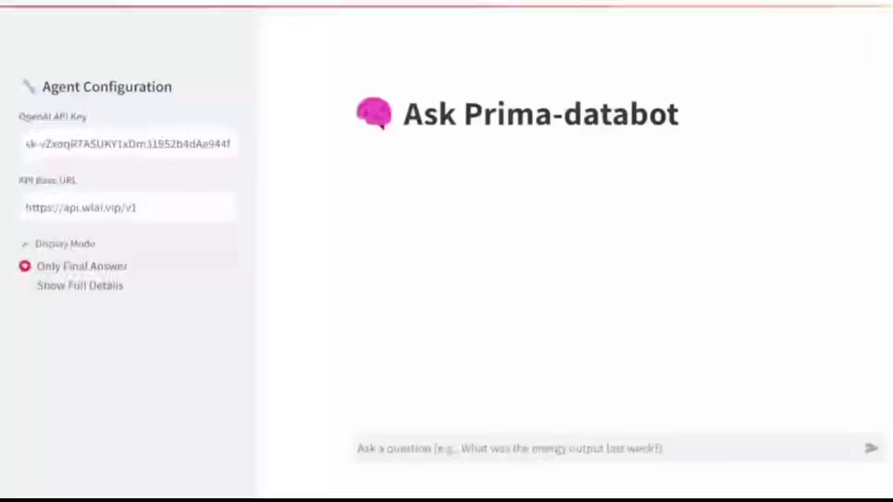
Prima-databot Demo

Slide 8
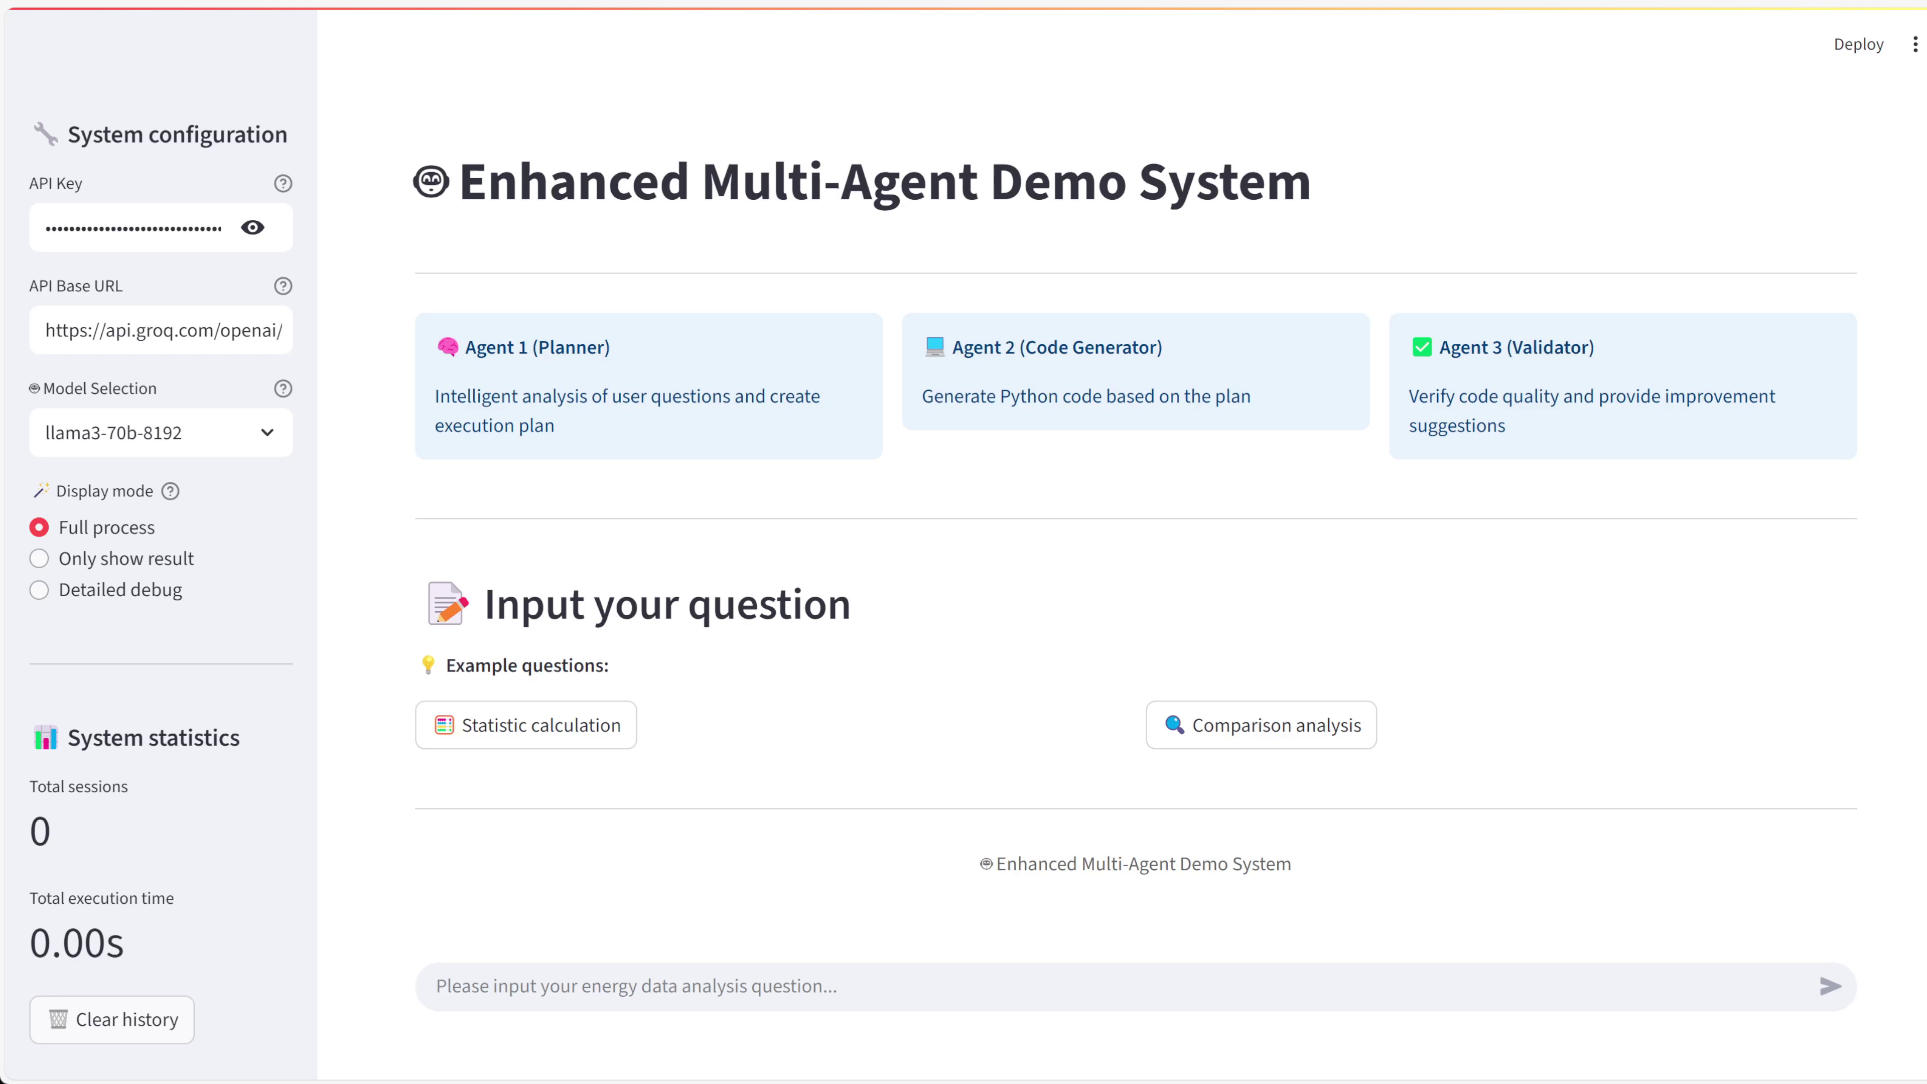
System demo

Slide 9
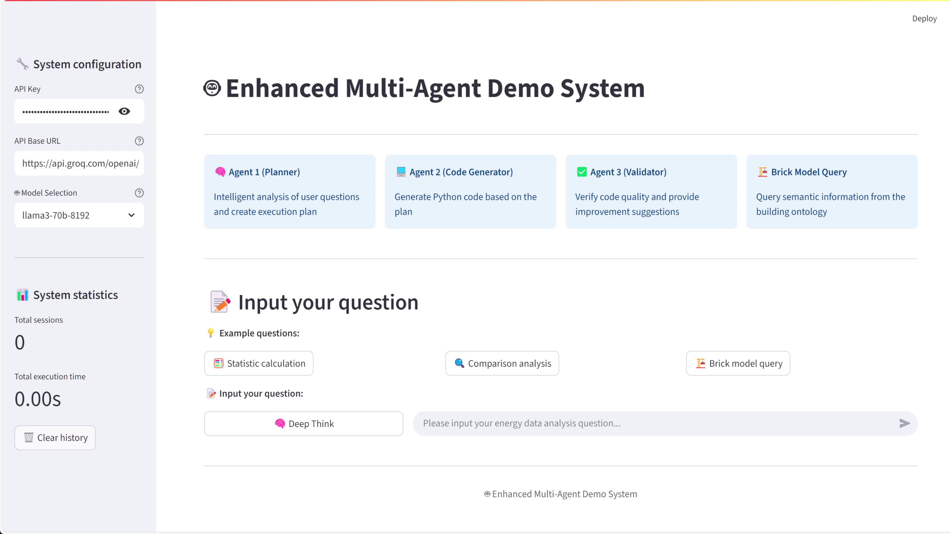
Demo

Slide 10
Key research question
Data query challenge
Data analysis challenge
How can the PV site involved in the user problem be identified to call the correct siteID from brick model?
How to use API to call the time-seires data for the specific siteID within the time period involved in user problem?
How to make automated data analysis？

Slide 11
Key research question
Data query challenge
Data analysis challenge
How can the PV site involved in the user problem be identified to call the correct siteID from brick model?
How to use API to call the time-seires data for the specific siteID within the time period involved in user problem?
How to make automated data analysis？
User problem: Find the minimum power for the Atrium_Zone_A2_Added_panels between May 10, 2023, and May 15, 2023.

Slide 12
Key research question
Data query challenge
Data analysis challenge
How can the PV site involved in the user problem be identified to call the correct siteID from brick model?
How to use API to call the time-seires data for the specific siteID within the time period involved in user problem?
SPARQL query
API call
How to make automated data analysis？
Python + Pandas
User problem: Find the minimum power for the Atrium_Zone_A2_Added_panels between May 10, 2023, and May 15, 2023.
PV site: Atrium_Zone_A2_Added_panels
Time period: 2023-5-10 to 2023-5-15.

Slide 13
Key research question
Data query challenge
Data analysis challenge
Scripting
How can the PV site involved in the user problem be identified to call the correct siteID from brick model?
How to use API to call the time-seires data for the specific siteID within the time period involved in user problem?
SPARQL query
API call
How to make automated data analysis？
Python + Pandas
Intent retieving
User problem: Find the minimum power for the Atrium_Zone_A2_Added_panels between May 10, 2023, and May 15, 2023.
PV site: Atrium_Zone_A2_Added_panels
Time period: 2023-5-10 to 2023-5-15.

Slide 14
New insight
LLM-based agent
Code-based agent
Intent retieving
LLM could extract PV site and time period from the problem using natural language.
User problem: Find the minimum power for the Atrium_Zone_A2_Added_panels between May 10, 2023, and May 15, 2023.
PV site: Atrium_Zone_A2_Added_panels
Time period: 2023-5-10 to 2023-5-15.
LLM could break down the task into primitives.
Planning
Scripting
Make agent gains access to utility functions and make script to slove the task automatically.
Utility functions of query generated by agent: SPARQL + Pandas + API url generation

Slide 15
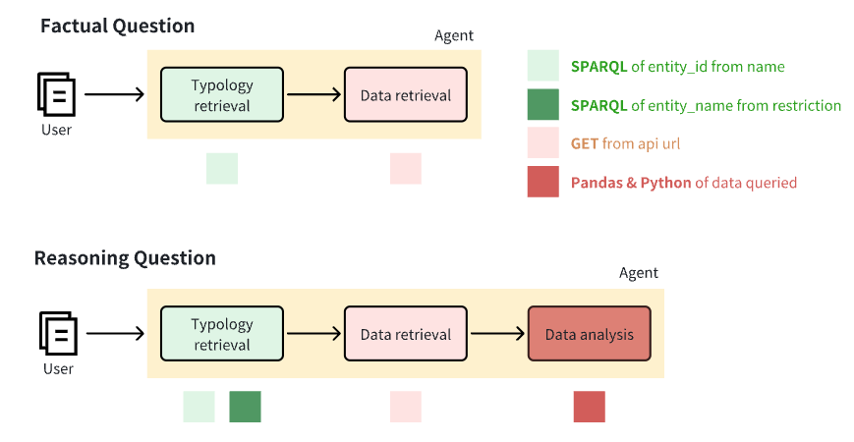
Our approach: Prima-databot
Key idea
Design overview
Tool-augmented LLM agent: Infer utility functions document as Toolkit, so that it can use function to code script while decompositing task.
Propose a workflow of agent.
Design a prompt for agent to get access to utility functions and coding.

Slide 16
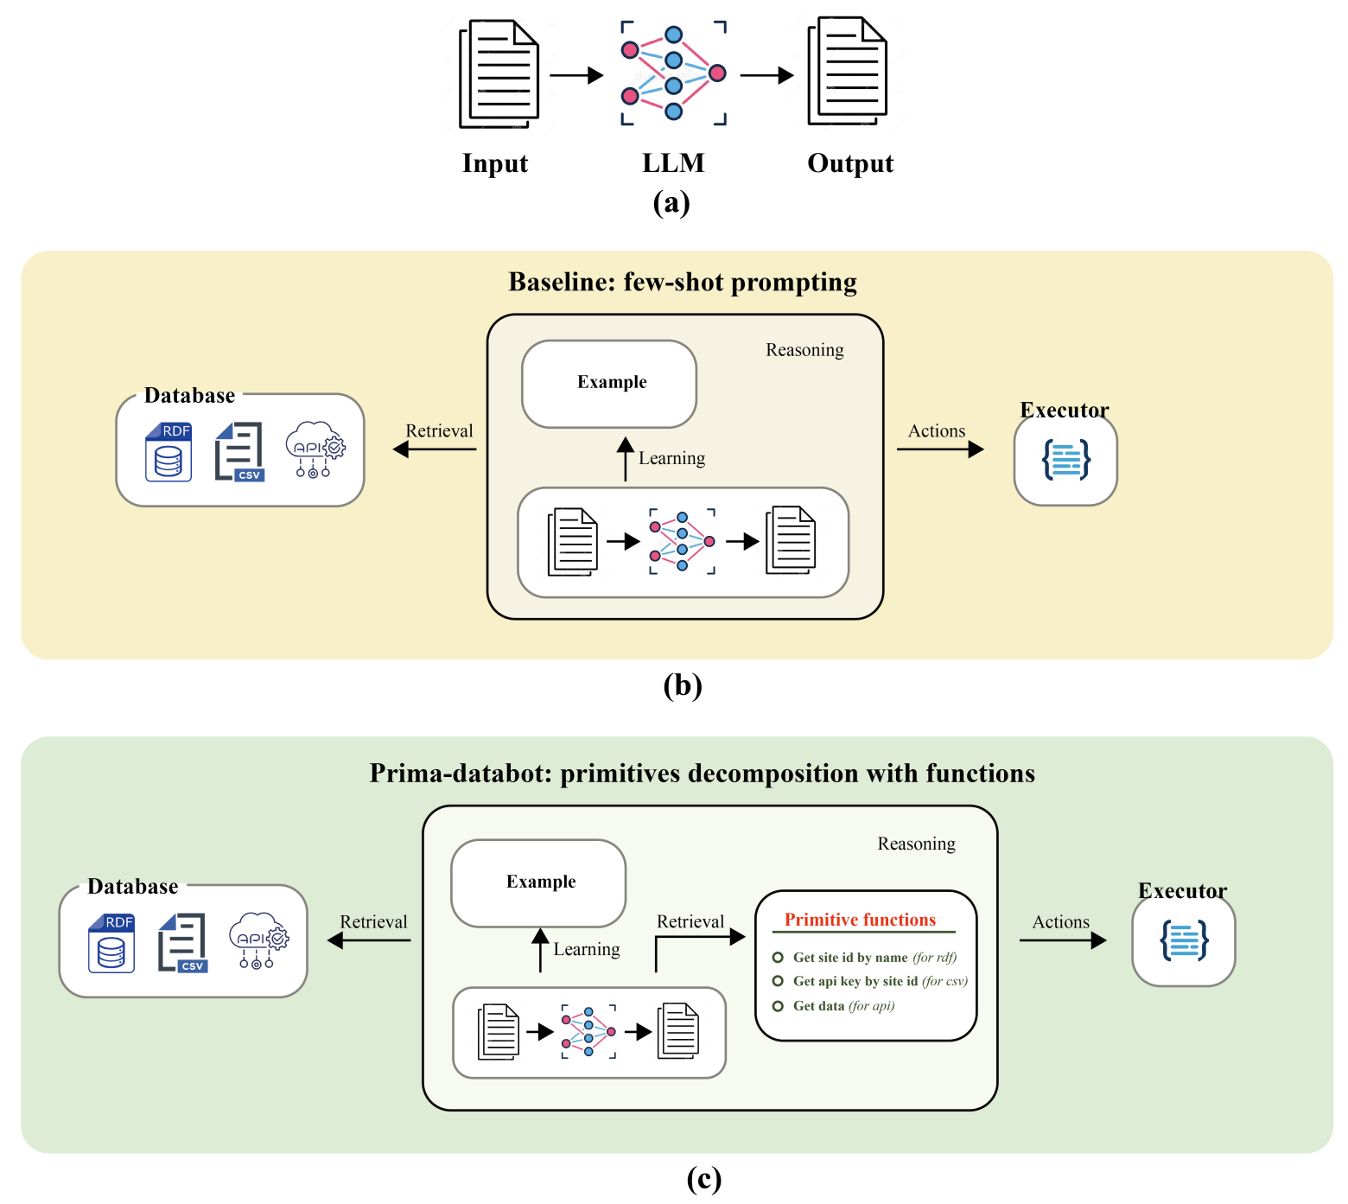
Our approach

Slide 17
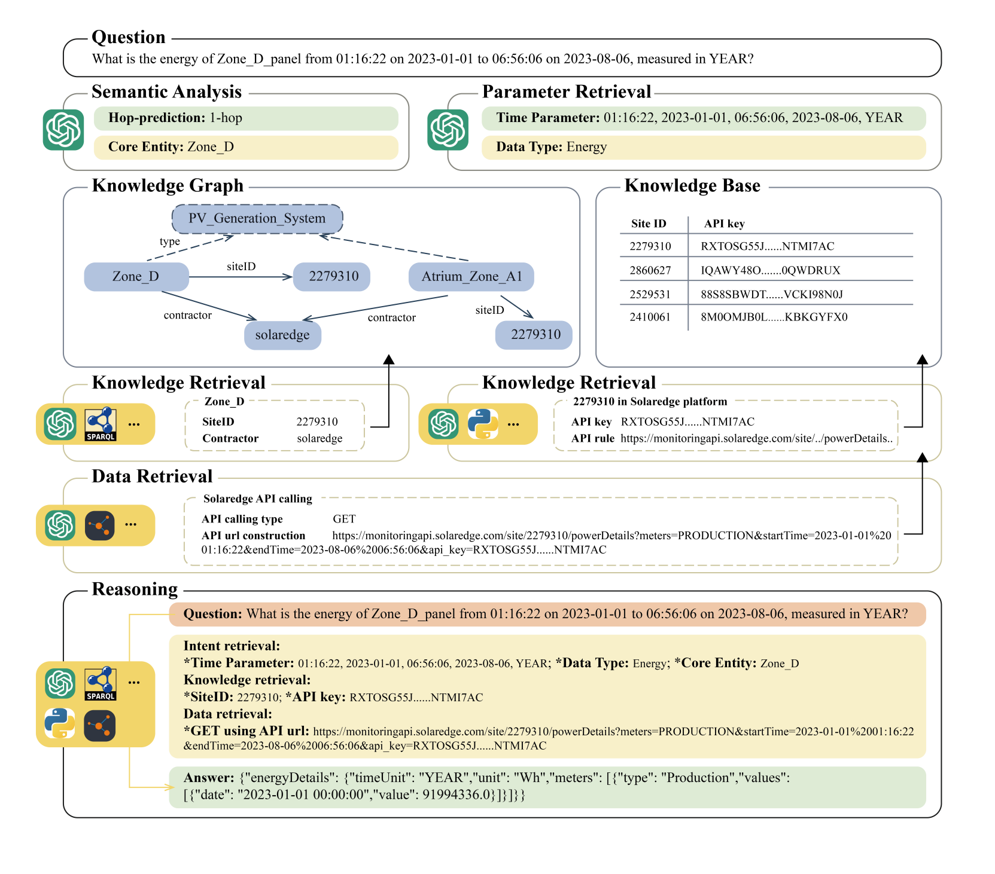
Case

Slide 18
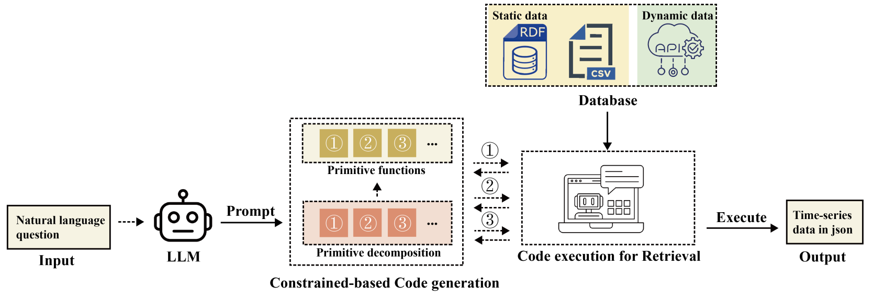
Workflow

Slide 19
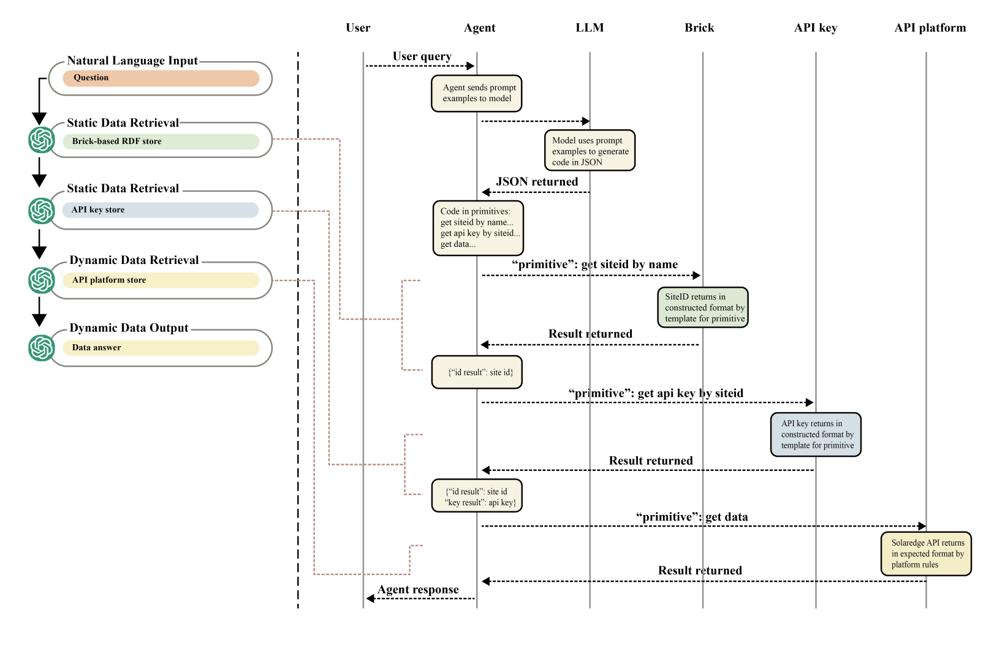
Pipeline

Slide 20
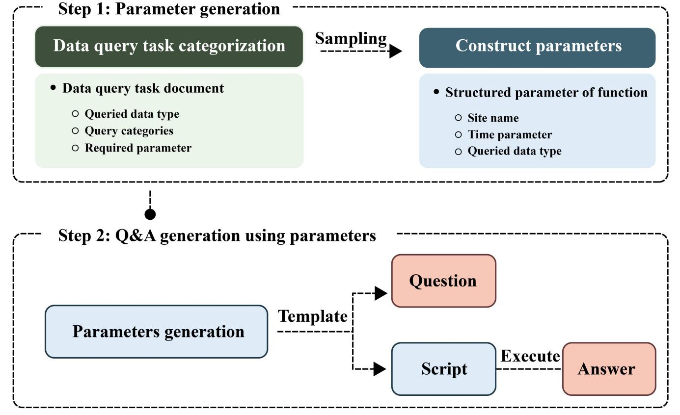
Experiment
Dataset generation

Slide 21
Experiment
Quantitative evaluation results
Method (model) | Task completion rate
Few-prompting Baseline(GPT-4o-2024-08-06) | 13.29%
Prima-databot(GPT-4o-2024-08-06) | 98.14%

Slide 22
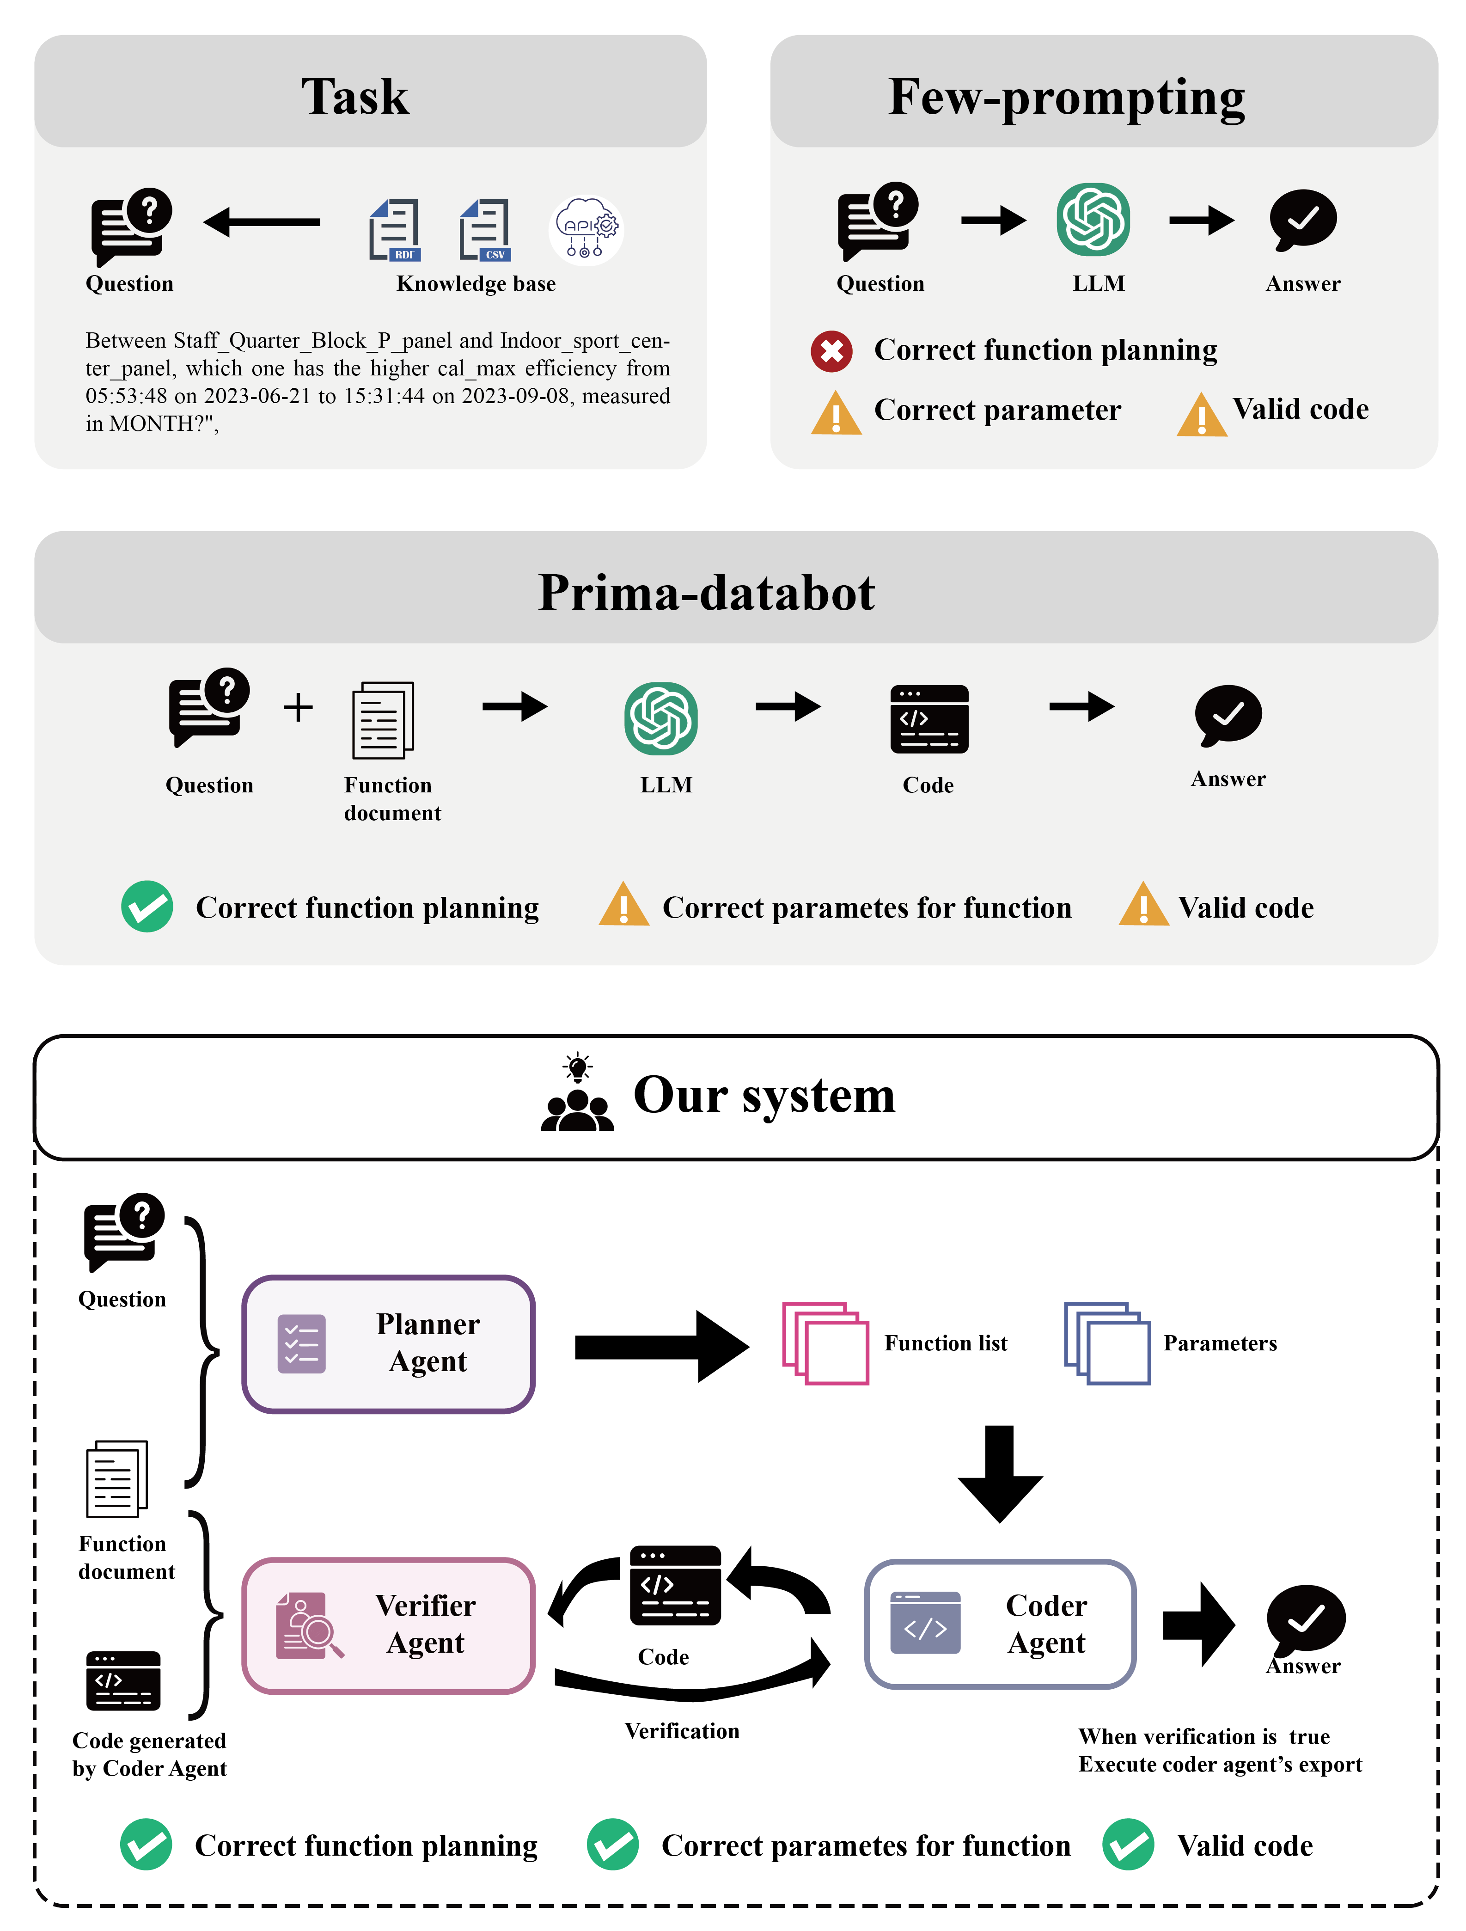
Our system

Slide 23
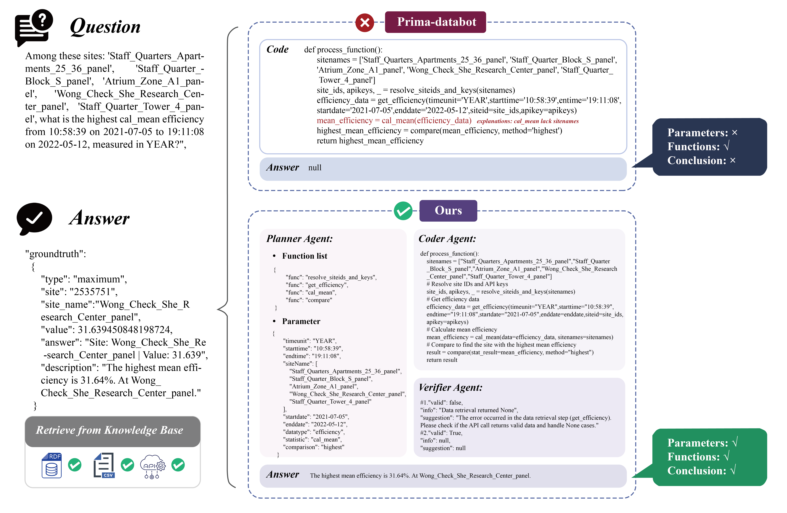
Case

Slide 24
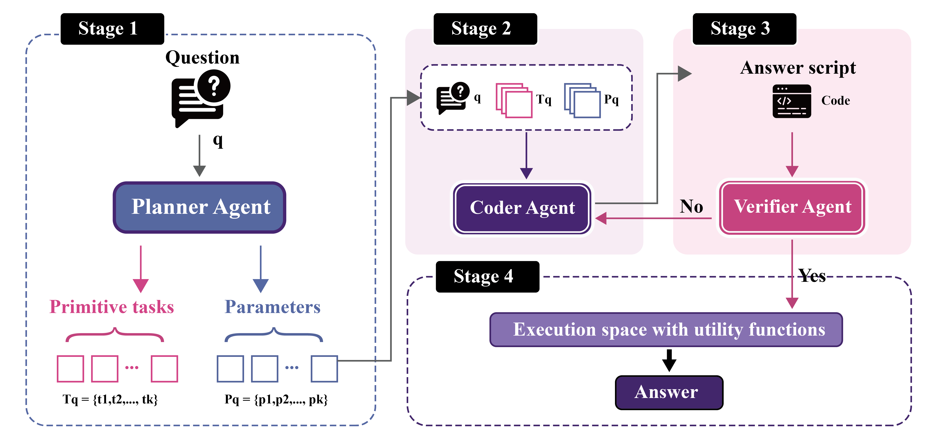
System workflow

Slide 25
System demo

Slide 26
Experiment
Dataset generation

Slide 27
Experiment
Quantitative evaluation results
Dataset group | Method | Task Completion Rate
Single entity（1076） | Baseline (Prima-databot) | 73.70%
 | Method (Multi-agent) | 99.99%
Multi entity（5045） | Baseline (Prima-databot) | 70.86%
 | Method (Multi-agent) | 95.48%

